Slide 1
AI 620 EMERGING TOPICS IN ARTIFICIAL INTELLIGENCE
Module 5
Voice Chatbot with Amazon Comprehend

Slide 2
Learning outcomes
Building conversational interfaces with Amazon Lex
Implementing task fulfillment logics with AWS Lambda
Adding a RESTful API in front of Amazon Lex custom AI capability
Discussing design concerns for conversational interfaces

Slide 3
Contact assistant
In this chapter, we will be implementing an intelligent assistant, called Contact Assistant, for searching contact information. The contact assistant will work with the same contact data store we created for the contact organizer project in Chapter 5, Extracting Information from Text with Amazon Comprehend. We will also add a RESTful API in front of the contact assistant, giving us multiple applications to leverage its capabilities. The way this intelligent assistant is designed makes it most useful out in the field, for example, when a traveling salesman is driving to a client and needs to get the client's contact information verbally. Instead of performing the searches through a web application running in a browser, this use case is better suited to be a mobile application with a driver-friendly user interface. This mobile application and its user interface are beyond the scope of this book, but may turn out to be interesting hands-on projects for some of you.

Slide 4
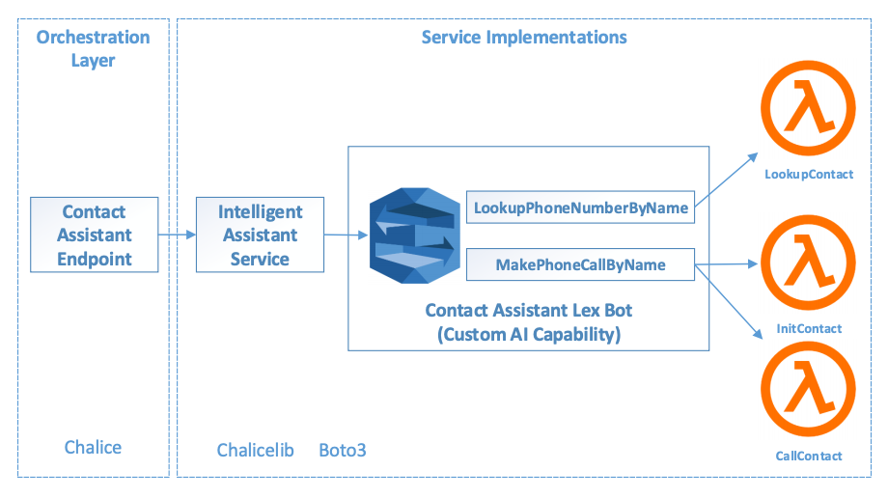
Contact Assistant architecture

Slide 5
No UI layer
The above architecture does not include the user interface layer, since we will not be implementing the mobile or web application that connects to the contact assistant. Instead, we will be focusing our efforts on developing a custom AI capability, an intelligent assistant bot, using the Amazon Lex platform.

Slide 6
The architecture includes
In the orchestration layer, we will build a Contact Assistant Endpoint that provides a RESTful interface to access our contact assistant's capabilities.
In the service implementation layer, we will build a service, called the intelligent assistant service, that shields implementation details of our custom AI capability, including its Amazon Lex implementation details. This way, when we want to reimplement the contact assistant bot with a different chatbot technology, only the intelligent assistant service needs to be modified.

Slide 7
Amazon Lex
Amazon Lex is a development platform for building intelligent assistants or chatbots. With Amazon Lex, we are building our own custom intelligent assistant capabilities. Lex itself provides many AI capabilities, including Automatic Speech Recognition (ASR) and Natural Language Understanding (NLU), that are useful for building conversational interfaces. However, developers must follow Lex's development constructs, conventions, and norms to leverage these underlying AI capabilities.

Slide 8
Amazon lex building blocks
Bot
Intent
Sample utterance
Slot
Slot type
Prompt and response
Session attributes

Slide 9
Amazon lex hook types
The Amazon Lex platform focuses on building conversational interfaces; fulfillment of the automated tasks is delegated to AWS Lambda. There are two built-in hook types for developers to integrate lambda functions:
Lambda initialization and validation: This hook allows developers to write AWS Lambda functions to validate the user inputs. For example, the lambda function can verify a user's inputs from a data source and with more complex business logic.
The fulfillment lambda function: This hook allows developers to write AWS Lambda code that performs the task. With this lambda hook, developers can tap into AWS services, API endpoints, and much more to write the business logic for tasks such as checking the weather, ordering a pizza, and sending messages.

Slide 10
IMPLEMENTING THE PROJECT
PE05-1
1.1 Setting up the contact assistant bot
1.1 Follow textbook page208 step 1 to 8
1.2 LookupPhoneNumberByName intent setup
1.3 LookupPhoneNumberByName lambda function
1.4 Add lambda to the fulfillment hook
1.5 Test conversations for LookupPhoneNumerByName
1.6 MakePhoneCallByName intent
Repeat 1.2-1.5
1.7 Deploying the contact assistant bot

Slide 11
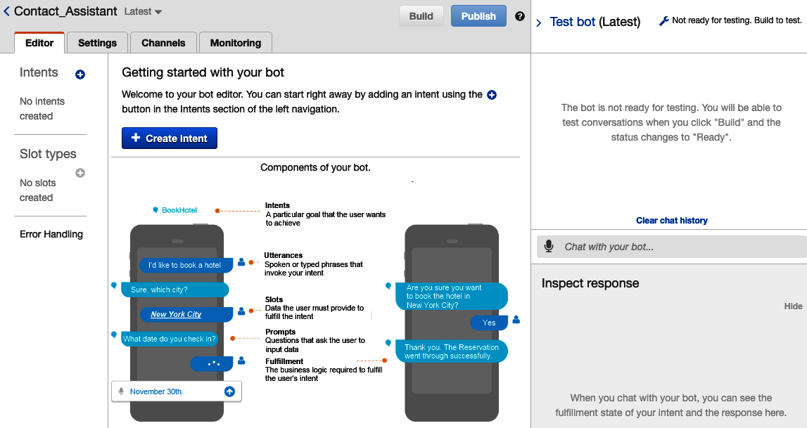
1.1 Lex development console

Slide 12
1.1 Lex development console
The bot's name can be found in the top-left corner, Contact_Assistant.
There are a pair of disabled buttons for Build and Publish in the top-right corner.
Below the bot name and buttons are the tabs for Editor, Settings, Channels, and Monitoring screens. We will perform most of our bot development in the Editor tab.
With the Editor tab selected, we see that no Intents or Slot types have been added to the contact assistant.
In the top-right corner of the screen, there is a Test bot sidebar that can be expanded (shown in the diagram) to reveal a chat interface. This chat interface is used to issue verbal commands to the bot under development. The chat interface is currently disabled. The bot needs to be built, with at least one intent created.
Finally, Click on the Create Intent button to build our first intent.

Slide 13
About 1.2 LookupPyhoneNumberByName intent
Our first intent allows the user to look up a contact's phone number by stating the contact's first and last names. This intent is essentially a search feature built on top of the contact store, but with a conversational interface.
We recommend designing each intent to focus on a narrow use case, and building up multiple intents to expand the bot's use cases.
This intent is used to query for information. Providing the information in the response will feel natural to users. There are also intents that will perform a task without the need to provide information back to the users. In such cases, it is still a good idea to respond to the users of the outcome of the task.

Slide 14
About 1.3 LookupPyhoneNumberByName lambda function
To perform any fulfillment action with the intelligent assistant, developers need to invoke AWS Lambda functions. The Fulfillment section provides a hook to an existing lambda function. Let's implement a lambda function called LookupPhoneNumberByName to search for the phone number of a contact by his or her first and last names.
In contrast to previous projects, where we used AWS Chalice to develop and deploy the lambda code and AWS permissions, we will be using the AWS Lambda console page to create the LookupPhoneNumberByName function.

Slide 15
About 1.5 Test conversations for LookupPhoneNumerByName
In the test conversation, the following is expected to happen:
The utterance did not include the slots, and our contact assistant prompted for the first and last names.
The assistant confirmed the lookup for John Smith before proceeding with fulfillment.
The response included the contact's first name and the phone number.

Slide 16
About 1.6 MakePhoneCallByName intent
Follow 1.2 to 1.5 to setup MakePhoneallByName intent.
The task performed by this intent should be obvious from its name; it can phone the contacts. However, we will not be implementing the phone call functionality in this project.
The goal as regards implementing this second intent is to demonstrate how multiple intents of an intelligent assistant can interact and collaborate.

Slide 17
IMPLEMENTING THE PROJECT
PE05-2 Integrating the contact assistant into applications
2.1 Setup projects following textbook page 235 step 1 to 5
2.2 Implementing assistant service implementation
2.3 Contact assistant RESTful endpoint
DONE!

Slide 18
References
Tripuraneni, S., & Song, C. (2019). Hands-On Artificial Intelligence on Amazon Web Services. Packt Publishing. https://learning.oreilly.com/library/view/hands-on-artificial-intelligence/9781789534146/

